Slide 1
Theory of Computation
Brandon Cano

Slide 2
Option 2 – Using Python
CFG Datatype
non_terminals # set(string)
terminals # set(string)
start_symbol # string
productions # dictionary {string : list(string)}
PDA Datatype
states # set
input_aplha # set
stack_aplha # set
transitions # list[tuple(current_state, target_state, stack_operation)]
start_state # string
start_symbol # string
final_states # set

Slide 3
Creating GraphViz of a PDA
1. created all the states
2. added all transitions
3. specified the starting state
4. specified the final state
5. left to right graph view
One issue is that the graph sometimes likes to overlap different transition labels

Slide 4
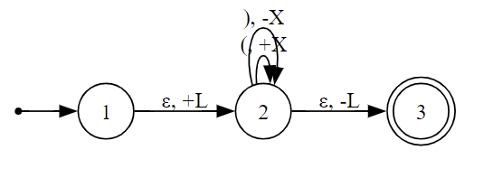
Example

Slide 5
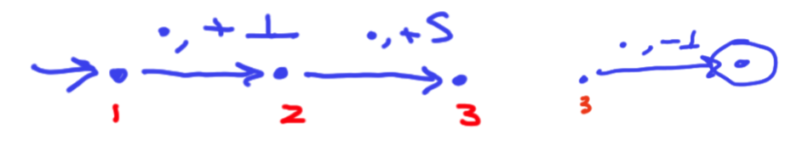
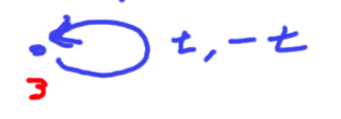
Translating CFG to a PDA
Take CFG elements and add to attributes that we can right away
Set the initial set of states and transitions based on this
Then for each production we take the NT and subtract it, then add all elements in its production and go back to state 3
Then we add the terminals transitions
Then we return the new PDA datatype

Slide 6
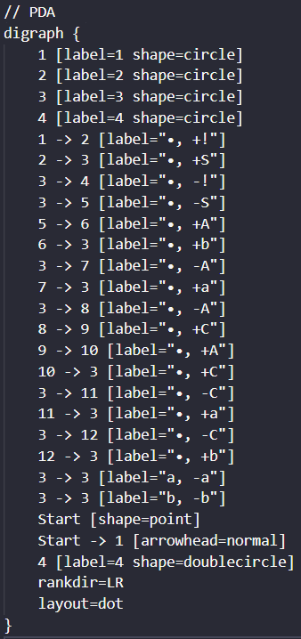
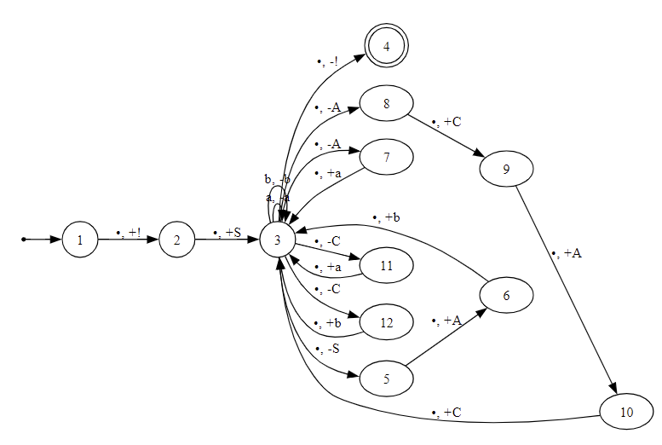
Example
CFG Productions:
{'S': ['A b', ' '],
'A': ['a', 'C A C'],
'C’: ['a', 'b']}

Slide 7
Translating a CFG to CNF
Each different step in the algorithm has its own set of for loops and conditions
Have a list of available uppercase letters for non-terminals (updates as new NTs are created)
First, we check for: N → s B s’ and B → , add N → s s’
Then remove I epsilon-productions
Then: Replace terminal t with new nonterminal Tt, and add Tt → t
Finally: Split X → Y1 ... Yk (for k > 2) into X → Y1 Z1 Z1 → Y2 Z2 ... Z(k-2) → Y(k-1) Yk
Limitations:
Currently the program lacks the ability to properly remove unit-productions and add new productions for the case: N -> B, B -> s, add N -> s

Slide 8
Example
Working:
Grammer: {'S': ['S S', '( S )', ' ']}
In CNF: {'S': ['S S', 'A C', 'A B’],
'A': ['('],
'B': [')’],
'C': ['S B']}
Not Working:
Grammer: {'N': ['B'], 'B': ['s’]}
In CNF: {'N': ['B'], 'B': ['A'], 'A': ['s']}

